Slide 1
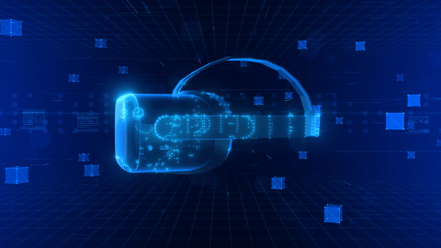
Surveillance in the Metaverse
June 6th, 2022
Anthony Dezilva

Slide 2
Looking through ‘my’ lens
The opinions expressed here, if controversial; are solely the opinions of the individual and does not reflect on any organization or association I am affiliated with.
Notes:
Who made a note in their head to listen for where I am being controversial. Conditioned the listening.
Lets complete that. The point was we can become conditioned, unknowingly.

Slide 3
Conditioning the listening
Classical Conditioning – Pavlov’s Dog – Stimulus-Response
Operant Conditioning – Skinner – Caged Rats
If they pressed the lever food will be provided

Slide 4
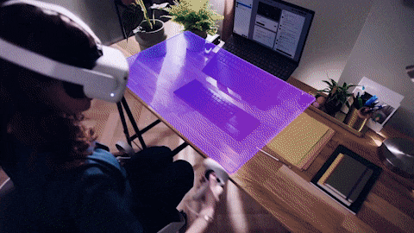
What is the Metaverse?
How would you define it?
about “MEMBERSHIP”. A sense of belonging: “Others like me”, “safe space”?..
All of the above:
At the end of the day, the human psyche is the consumer. Products are going to need to fulfill the needs of the ‘ID’.
The value of your products are going to be based on how your consumers ‘feel’ about them and ‘enroll’ others in that feeling.
Notes:
According to Freud's psychoanalytic theory, the id is the primitive and instinctual part of the mind that contains sexual and aggressive drives and hidden memories, the super-ego operates as a moral conscience, and the ego is the realistic part that mediates between the desires of the id and the super-ego.

Slide 5
What Is The Metaverse?
You may have heard about the Metaverse, but what exactly is it?
Wrapping ones’ mind around the Metaverse is probably akin to what it was like understanding the internet in the 1970’s.
Put broadly, the Metaverse is a shift in how we interact with technology
Sternlicht, L. & Sternlicht, A. (2022). A New Age of Digital Addiction - What The Metaverse Means for Mental Health and Digital Addiction.

Slide 6
Is it?
A world, where we are transacting in currency not limited to the monetary policy of a nation but defined by a computational algorithm at a global level.
We are participating in social interactions that are not limited by the bounds of a map, or culture; but a global one, that’s generated second by second, by the participants themselves.
We are following and idealized reality, with the ability to socialize and experience connectedness as a mental creation of that experience.
Notes:
.

Slide 7
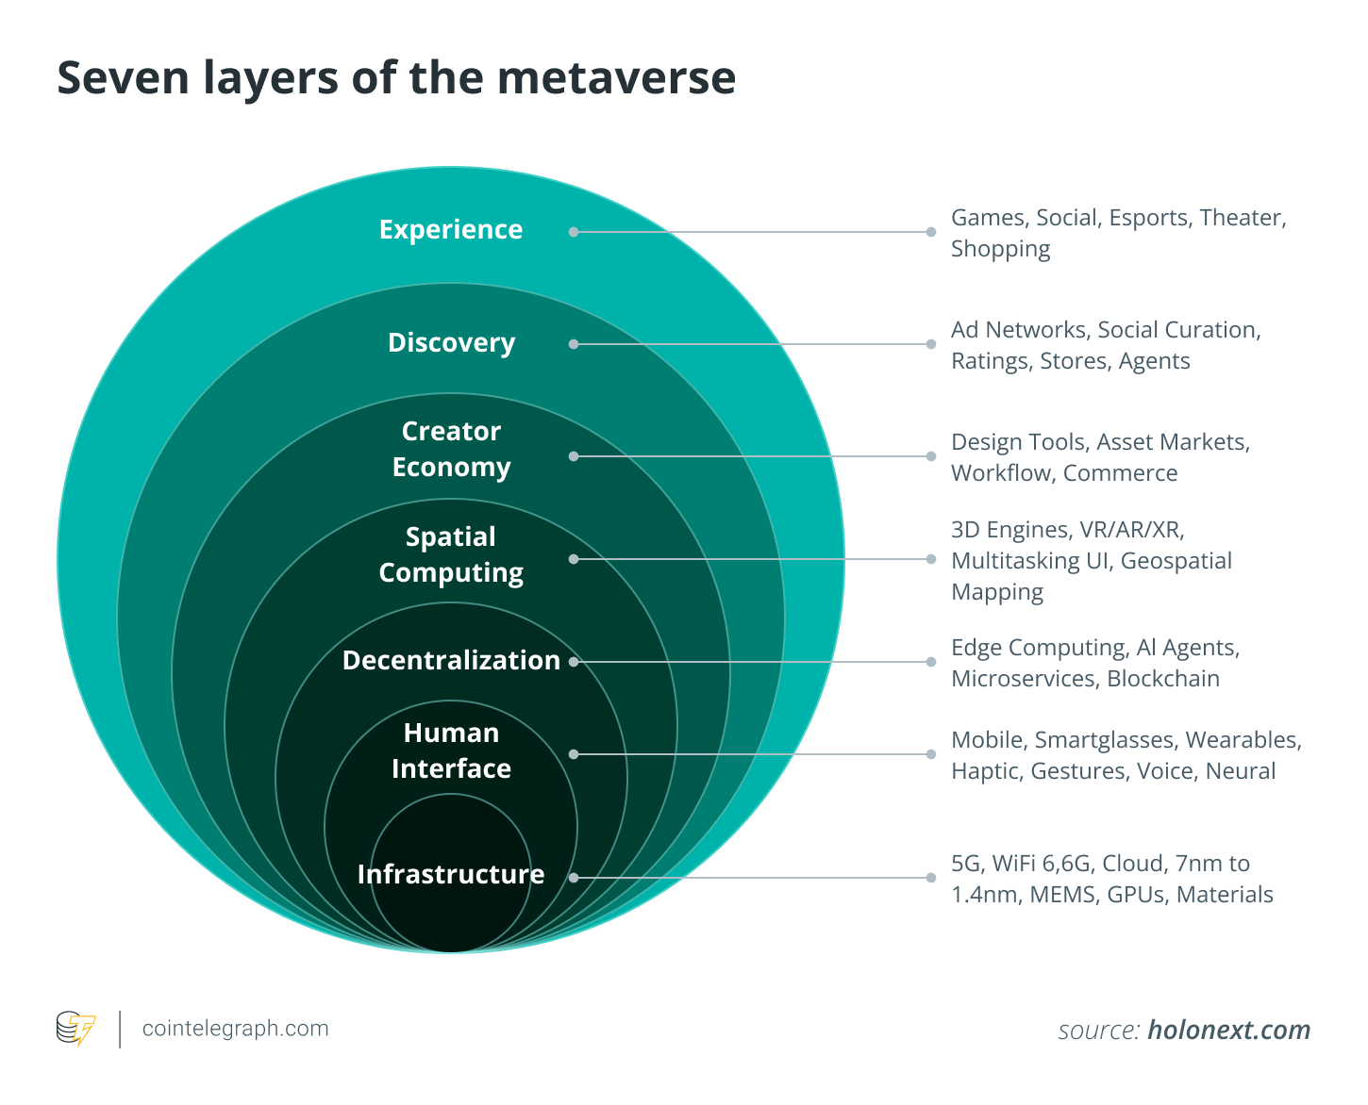
What will it take?
Data. Lots of it.
Verbal
Typed
Thoughts
Movements
GeoSpacial Location
Proximity to various known triggers
Habits
Likes / Dislikes
Current Mood
Biological Characteristics
Heart Rate, Blood Pressure, Pupil movement and dilation, temperature, sweating, activity type detection
Etc
Etc
Etc ……………..

Slide 8
Who’s making meta moves?
Game studios quickly integrated the Metaverse into their business plans. An online casino has become one of the most popular games in Decentraland, with 600,000 visitors every month who have netted $15.4 million in payouts
McDonald's, Panera Bread, and Wingstop each announced plans to sell virtual food in the Mtaverse.
The travel industry could use the Metaverse to sell luxury trips with VR previews of destinations, hotel rooms, and first-class seats
At least ten Chinese cities have included the Metaverse in their economic development plans. China’s industry committee designed to promote the Metaverse now has 112 member companies
You Exec (2021). What products do major companies have in development for the metaverse?

Slide 9
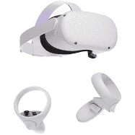
The tools to experience Metaverse
VR/AR/XR Visual Stimulation
VR – Full Emersion
AR – Integration into environment
Body Sensors
Temperature, Sweat, Heat rate, Stride, sleep patterns
Other Sensors
Geospatial location, proximity to interesting object
Sensory Enhancement
Others
HP VR Backpack
I7-8850H, 32GB RAM, 512GB
4 Hotswap batteries

Slide 10
Crime in the metaverse
“Cyber crime in metaverse: How do we defend against a virtual action, in a virtual world, with no borders, where the action may not translate into the physical world; therefore, no state, federal or even international laws are relevant?”
Using Minecraft as an example, people can spend years building their virtual existence, and if it were destroyed, the need for justice will be as real as it is in the physical world.
So what is Cyber security going to look like in the future:
Protect the compute infrastructure it takes to keep the virtual existence alive
Protect the interfaces that connect the ‘fleshy’s to the ‘avatars’.
Apply Chaos theory for pattern/anomaly recognition
Drive new laws and methods of law enforcement

Slide 11
Digital Addiction?
The Metaverse and Relationships
Social media was meant to connect us, and in many ways it has, but it can also be argued that it has driven us to be more alone and distant than ever. Interactions via social networks are not as authentic or satisfying as real-world relationships. Social media users often believe they are connecting with friends or family via social networks, but really they are at home and alone.
The Metaverse and Mental Health
Digital use can bring escape and relief from the stresses of life and invoke temporary pleasure, but excessive digital use is associated with many mental health issues including depression, irritability, stress, paranoid ideation, somatic symptoms, and psychoses, among others.
Sternlicht, L. & Sternlicht, A. (2022). A New Age of Digital Addiction - What The Metaverse Means for Mental Health and Digital Addiction.

Slide 12
Digital Addiction?
Covid has conditioned our children to be afraid of each other. However as humans we yearn for contact with other humans. The Covid bias will therefore push this entire generation to create those relationships in a virtual space.
The focus here is that with Humans so plugged in, the impact of social engineering will be more pronounced. The humans will be hacked vs the machines they work on.
Sternlicht, L. & Sternlicht, A. (2022). A New Age of Digital Addiction - What The Metaverse Means for Mental Health and Digital Addiction.

Slide 13
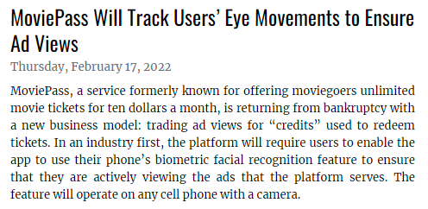
Creepy?
National Law Review (2022). MoviePass Will Track Users’ Eye Movements to Ensure Ad Views, Volume XII, Number 156

Slide 14
Conditioning / Assimilating
Tech companies are targeting their social media and metaverse platforms at this highly suggestible demographic — during an important stretch of their brains’ mental and emotional development — with potentially dire consequences.
VRChat, already shows evidence of dangers for young users. In December, research from the nonprofit Center for Countering Digital Hate (CCDH) found that minors were regularly exposed to graphic sexual content, racist and violent language, bullying and other forms of harassment on VRChat’s platform
Huddleston Jr, T (2022). ‘This is creating more loneliness’: The metaverse could be a serious problem for kids, experts say.

Slide 15
Disinformation
If you look at the history of social media over the past decade, you’ll see how it’s made us susceptible to misinformation and distortions. From deepfakes and botnets to fake news and troll farms, all live on social media, and we have no control over them. And on the flip side of the coin, they do have a psychological control over what we perceive to be real.
What vulnerabilities are likely to exist on a human host? Cognitive psychology has a lot to offer on this topic… our cognitive processing is a mosaic of heuristics, biases and mental shortcuts that make it easy for us to make sense of our the complex world around us. Every bias or mental shortcut comes with a corresponding vulnerability that can be exploited by disinformation, the same way malware may exploit an issue with how information is processed on your laptop.
Manrod, M. (2022). Malware of the Mind - Disinformation and Manipulation via Social Platforms
https://www.linkedin.com/pulse/mental-malware-dont-get-infected-michael-manrod?trk=public_profile_article_view

Slide 16
Questions?

